Slide 1
Electronic System Design ELC 441
” وما بكم من نعمة فمن الله “
Critical path determination
Prof. Serag E. D. Habib

Slide 2
Critical path determination in combinational circuits
Building block. Delays shown in blue
Considered Example

Slide 3
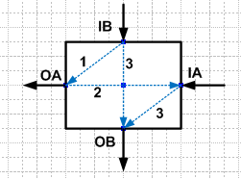
Critical path determination in combinational circuits
0
0
0
0
6
4
2
7
5
3
6
8
10
12
10
11
13
Arrival times in green
Critical path 1: cell a_IA > cell b_IA > cell c_IA > cell d_IA > cell e_IA > cell f_OB
Alternative Critical path 1: cell a_IA > cell b_IA > cell c_IA > cell d_IB > cell e_IA > cell f_OB

